Slide 1
Chapter 1: Getting Started with Servlets

Slide 2
Learning Objectives
Introduction
Web application Architecture
Http Protocol & Http Methods
Web Server & Web Container
Servlet Interface
GenericServlet, ServletRequest, and ServletResponse
HttpServlet, HttpServletResponse and HttpServlet

Slide 3
Pre-Requisites
Apache Tomcat
Spring Tools Suite (IntelliJ Idea also supports Servlet Development but is available only in Enterprise edition - which is paid, we will use STS, alternatively you can also use NetBeans).
MySql database server (with MySql workbench)
Basic understanding of HTTP and HTML
HTTP Verbs (GET, POST, PUT and DELETE)
HTML Markup and Tags
HTML Forms

Slide 4
Servlets - Overview
Java Servlets are programs that run on a Web or Application server and act as a middle layer between a requests coming from a Web browser or other HTTP client and databases or applications on the HTTP server.
Using Servlets, you can collect input from users through web page forms, present records from a database or another source, and create web pages dynamically.
Java Servlets often serve the same purpose as programs implemented using the Common Gateway Interface (CGI). But Servlets offer several advantages in comparison with the CGI.
Performance is significantly better.
Servlets execute within the address space of a Web server. It is not necessary to create a separate process to handle each client request.
Servlets are platform-independent because they are written in Java.
Java security manager on the server enforces a set of restrictions to protect the resources on a server machine. So servlets are trusted.
The full functionality of the Java class libraries is available to a servlet. It can communicate with applets, databases, or other software via the sockets and RMI mechanisms that you have seen already.

Slide 5
Servlets Architecture

Slide 6
Servlets - Use cases
Read the explicit data sent by the clients (browsers). This includes an HTML form on a Web page or it could also come from an applet or a custom HTTP client program.
Read the implicit HTTP request data sent by the clients (browsers). This includes cookies, media types and compression schemes the browser understands, and so forth.
Process the data and generate the results. This process may require talking to a database, executing an RMI or CORBA call, invoking a Web service, or computing the response directly.
Send the explicit data (i.e., the document) to the clients (browsers). This document can be sent in a variety of formats, including text (HTML or XML), binary (GIF images), Excel, etc.
Send the implicit HTTP response to the clients (browsers). This includes telling the browsers or other clients what type of document is being returned (e.g., HTML), setting cookies and caching parameters, and other such tasks.

Slide 7

HTML Forms
HTML Forms are required, when you want to collect some data from the site visitor. For example, during user registration you would like to collect information such as name, email address, credit card, etc.
A form will take input from the site visitor and then will post it to a back-end application such as CGI, ASP Script or PHP script, Java Servlet etc. The back-end application will perform required processing on the passed data based on defined business logic inside the application.
There are various form elements available like text fields, textarea fields, drop-down menus, radio buttons, checkboxes, etc.

Slide 8
HTML Forms-Example
A simple student registration page to register students.
Assignment(ToDo): Create a simple servlet to display all registered students.

Slide 9
Servlet - Life Cycle
The lifecycle of a servlet is controlled by the container(Tomcat, Jetty etc) in which the servlet has been deployed. The life cycle contains the following steps:
Servlet Class is loaded.
Servlet Instance is created.
init() method.
service() method.
destroy() method.
Servlet Class is loaded:
Before a servlet can be invoked the servlet container must first load its class definition. This is done just like any other class is loaded.
Servlet Instance is created:
The web container creates the instance of a servlet after loading the servlet class. The servlet instance is created only once in the servlet life cycle.

Slide 10
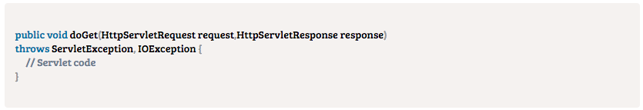
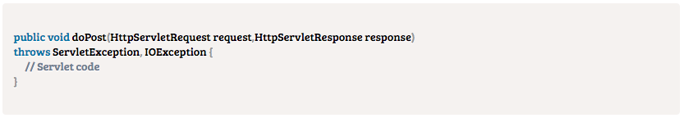
Servlet - Common Methods
The doGet() Method:
You should use doGet() when you want to intercept on HTTP GET requests or not specify any method.
The doPost() method:
You should use doPost() when you want to intercept on HTTP POST requests.

Slide 11
GenericServlet
A generic servlet is a protocol independent Servlet that should always override the service() method to handle the client request. The service() method accepts two arguments ServletRequest object and ServletResponse object. The request object tells the servlet about the request made by client while the response object is used to return a response back to the client.
GenericServlet is an abstract class and it has only one abstract method, which is service(). That’s why when we create Generic Servlet by extending GenericServlet class, we must override service() method.
Pros of using Generic Servlet:
1. Generic Servlet is easier to write
2. Has simple lifecycle methods
3. To write Generic Servlet you just need to extend javax.servlet.GenericServlet and override the service() method
Cons of using Generic Servlet:
Working with Generic Servlet is not that easy because we don’t have convenience methods such as doGet(), doPost(), doHead() etc in Generic Servlet that we can use in Http Servlet.

Slide 12
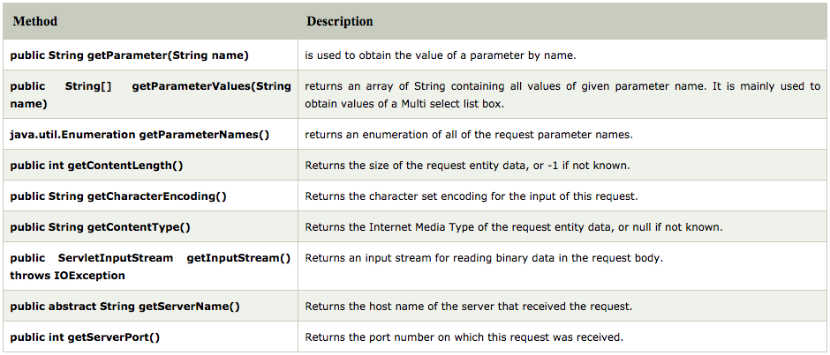
ServletRequest Interface
An object of ServletRequest is used to provide the client request information to a servlet such as content type, content length, parameter names and values, header informations, attributes etc.

Slide 13
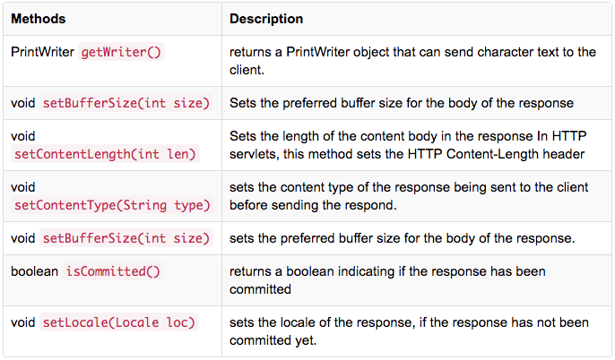
ServletResponse Interface
The servlet container is connected to the web server that receives Http Requests from client on a certain port. When client sends a request to web server, the servlet container creates HttpServletRequest and HttpServletResponse objects and passes them as an argument to the servlet service() method.
The response object allows you to format and send the response back to the client.

Slide 14
HttpServlet
The HttpServlet class extends the GenericServlet class and implements Serializable interface. It provides http specific methods such as doGet, doPost, doHead, doTrace etc.
Provides an abstract class to be subclassed to create an HTTP servlet suitable for a Web site. A subclass of HttpServlet must override at least one method, usually one of these:
doGet, if the servlet supports HTTP GET requests
doPost, for HTTP POST requests
doPut, for HTTP PUT requests
doDelete, for HTTP DELETE requests
init and destroy, to manage resources that are held for the life of the servlet
getServletInfo, which the servlet uses to provide information about itself.

Slide 15
HttpServletRequest
Extends the ServletRequest interface to provide request information for HTTP servlets.
The servlet container creates an HttpServletRequest object and passes it as an argument to the servlet's service methods (doGet, doPost, etc).
It exposes several methods specific to HTTP request received by the server.
We will look at the methods of HttpServletRequest in the code example.
A full list of HttpServletRequest can be found at: http://docs.oracle.com/javaee/6/api/javax/servlet/http/HttpServletRequest.html

Slide 16
HttpServletResponse
Extends the ServletResponse interface to provide HTTP-specific functionality in sending a response. For example, it has methods to access HTTP headers and cookies.
The servlet container creates an HttpServletResponse object and passes it as an argument to the servlet's service methods (doGet, doPost, etc).
It exposes several methods specific to HTTP response to be sent by the server.
We will look at the methods of HttpServletResponse in the code example.
A full list of HttpServletResponse can be found at: http://docs.oracle.com/javaee/6/api/javax/servlet/http/HttpServletResponse.html

Slide 17
What are we learning in Next Chapter ?
You will learn about Working with Servelets
We will learn about:
Servlet Lifecycle: init(), service(), destroy()
Accessing Parameters
ServletConfig
ServletContext
Servlet-Browser communication (sendError, setHeader, sendRedirect)
Web-component Communication (Forward, Include)

Slide 18
Thank You !

